Slide 1
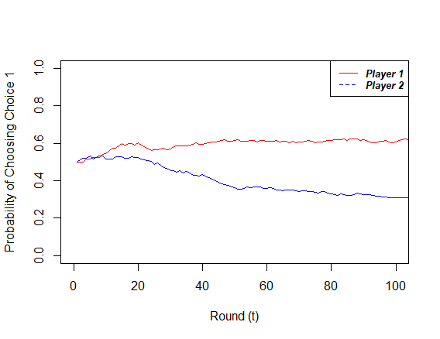
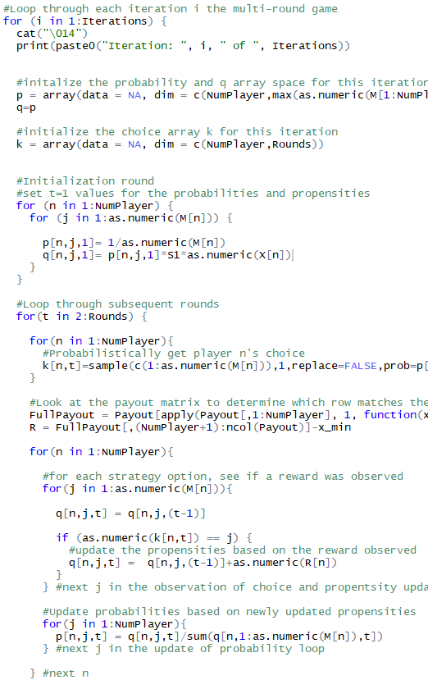
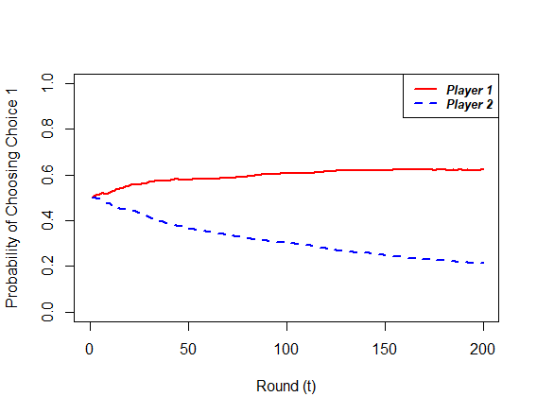
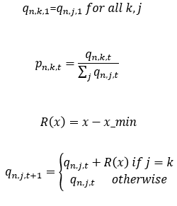
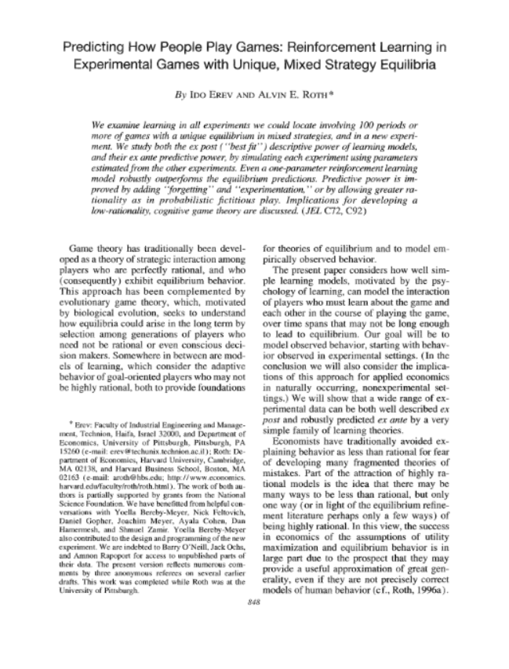
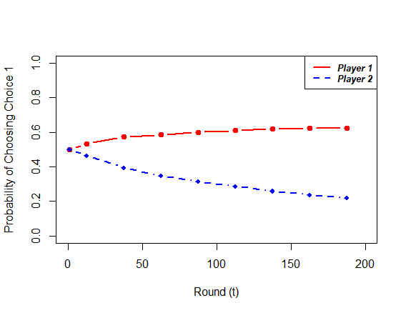
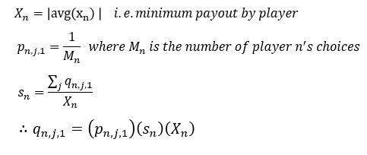
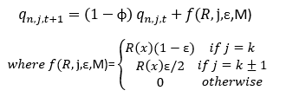
Replicating a Model:
Predicting How People Play Games: Reinforcement Learning in Experimental Games with Unique, Mixed Strategy Equilibria
By Ido Erev AND Alvin E. Roth
Presented by James Paine
February 15, 2019

Slide 2
Paper Background
Published in The American Economic Review in September 1998
Based, in part, on earlier work by Erev and Roth from 1995
Conducts a review of 12 previous studies of two player economic games
Presents three reinforcement learning models and compares the model to the empirical data from the previous studies
Concludes that the base, 1 parameter, model and the intermediary 3-parameter model, are able to replicate empirical data better (in general and when tuned) than equilibrium estimates
Base model has been generalized for other RL models and follows similar choice-theory work

Slide 3
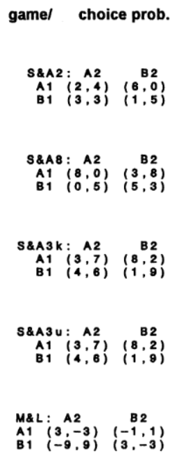
Model Details
Assumes players only see the results of their choices, i.e. have no knowledge of payouts a priori
Based on ‘propensities’ that change as players receive a reward for their actions
Each player probabilistically chooses based on the weighted value of the propensity of any choice relative to the other choices
Each model version adds elements to modify the propensity update routine
General routine:
Each player randomly picks an action based on their propensities
Payoffs by player are determined by the payout matrix
Players update their propensities based on the observed reward
Repeat above

Slide 4

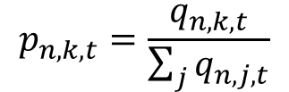
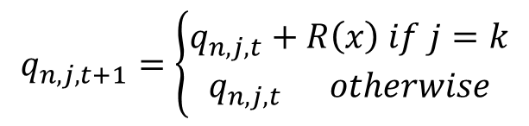

Model Details
In general, all propensities (q) start equal (at t=1 or t=0)
The probability (p) of any choice (j or k) is the relative weight of that propensity
Therefore, all choices have an equal chance at the first time step
The reward received is relative to the minimum reward possible
The propensity of a choice is updated if and only if that choice was chosen (k) and a reward was observed
$q_{n,k,1}$=$q_{n,j,1} for all k,j$
$$p_{n,k,t}=\frac{q_{n,k,t}}{\sum_{j}{q_{n,j,t}}}$$
$$R\left(x\right)=x−x_min$$
$$q_{n,j,t+1}=\left\{\begin{aligned}q_{n,j,t}+R\left(x\right) if j=k \\ q_{n,j,t} otherwise\end{aligned}\right.$$

Slide 5


Model Details
1-Parameter Model
Used parameter called ‘strength’ to determine the initial propensities
Value scales the rate at which the curves change (ie the ‘speed of learning’)
The above is used to initialize the model at the first time step
The value of this strength term was tuned in the paper to fit all 12 referenced datasets
$$X_{n}=\left|avg\left(x_{n}\right) \right| i.e. minimum payout by player$$
$$p_{n,j,1}=\frac{1}{M_{n}} where M_{n} is the number of player n^{′}s choices$$
$$s_{n}=\frac{\sum_{j}{q_{n,j,1}}}{X_{n}}$$
$$∴q_{n,j,1}=\left(p_{n,j,1}\right)\left(s_{n}\right)\left(X_{n}\right)$$

Slide 6
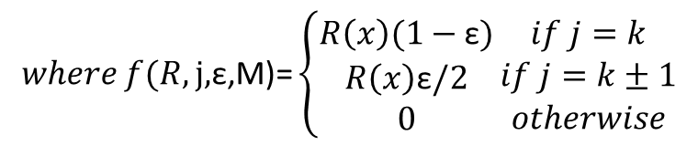

Model Details
3-Parameter Model
Keeps the ‘strength’ parameter to initialize the model
Adds two additional terms: ε (or ‘experimentation’) and φ (or ‘forgetting’)
φ essentially acts as a discount factor, reducing the importance of the current value of the propensity relative to the new reward
ε updates propensities of ‘nearby’ choice after a reward is realized
Note: there’s a slightly more complicated f() expression when the number of choices is greater than 2. This is incorporated into the R script
$$q_{n,j,t+1}=\left(1−\text{φ}\right) q_{n,j,t}+f(R,\text{j}\text{,}\text{ε}\text{,}\text{M}\text{)}$$
$$where f(R,\text{j}\text{,}\text{ε}\text{,}\text{M}\text{)=}\left\{\begin{aligned}R\left(x\right)(1−\text{ε}) \\ R\left(x\right)\text{ε}/2 \\ 0\end{aligned}\right.\begin{matrix}if j=k \\ if j=k±1 \\ otherwise\end{matrix}$$

Slide 7
Replication
Recreated the 1 parameter and 3 parameter models
R as the programming language
Standardized format for payout matrices for the referenced games
Code written to be flexible with any number of player choice combinations (so long as every player-choice combos is non-empty)
Matched the model terminology and structure from Erev and Roth
As opposed to later multiarm bandit, RL, choice models, or those of a similar structure
Used the published parameter values and visually compared my results to Erev and Roth

Slide 8
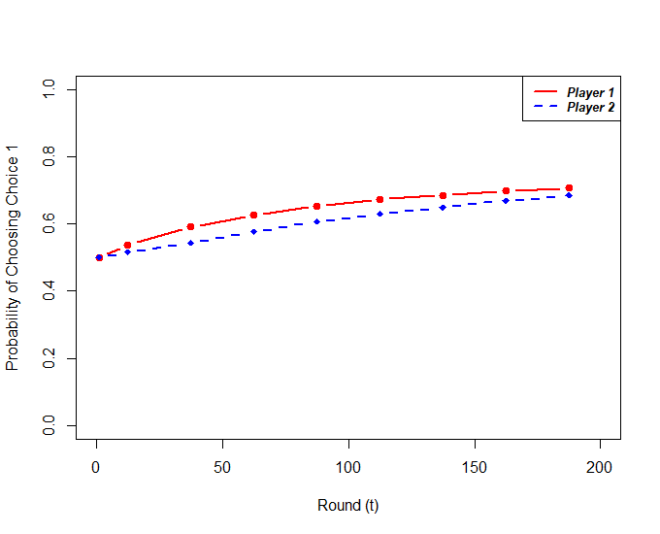
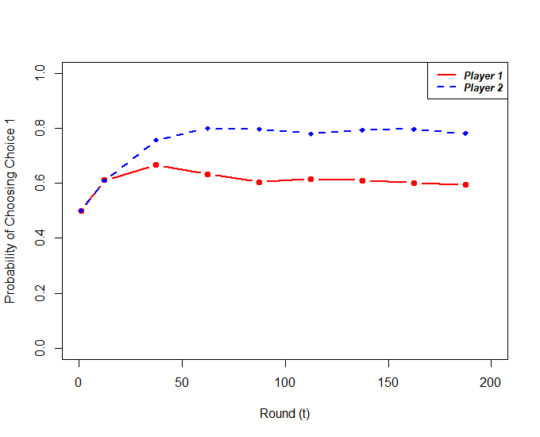
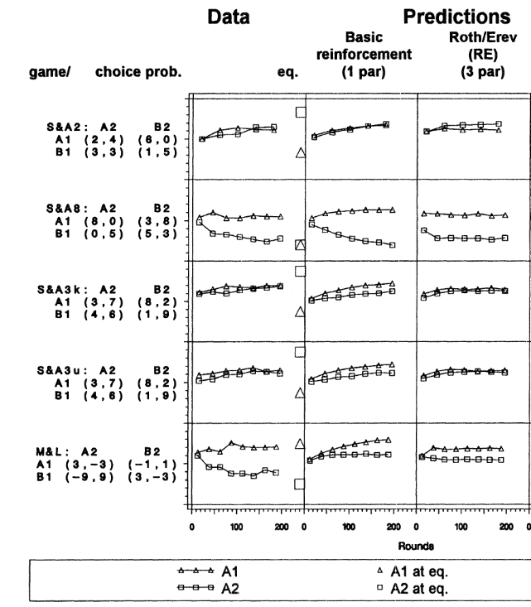
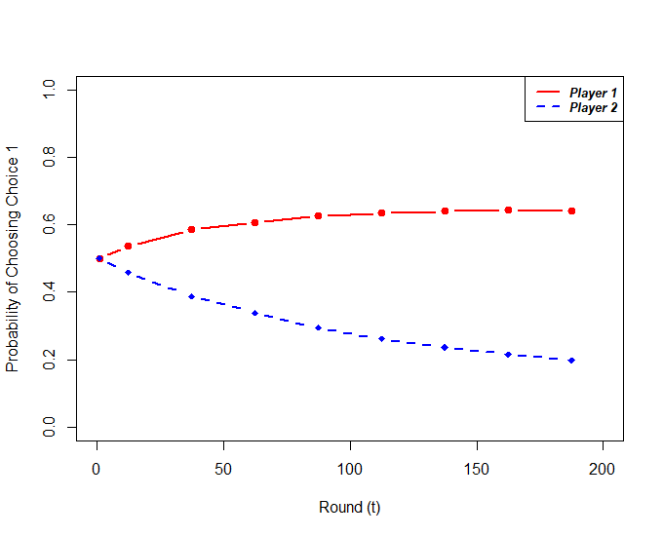
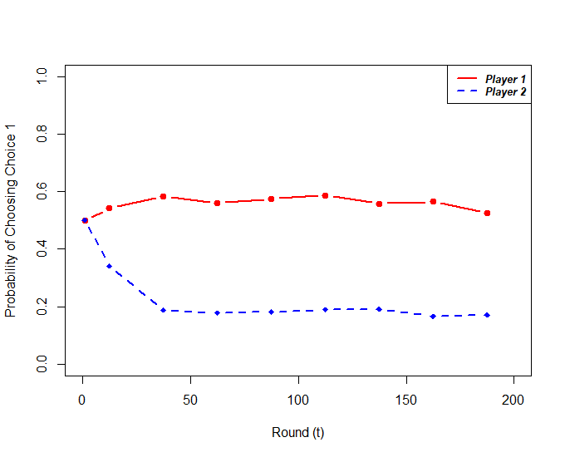
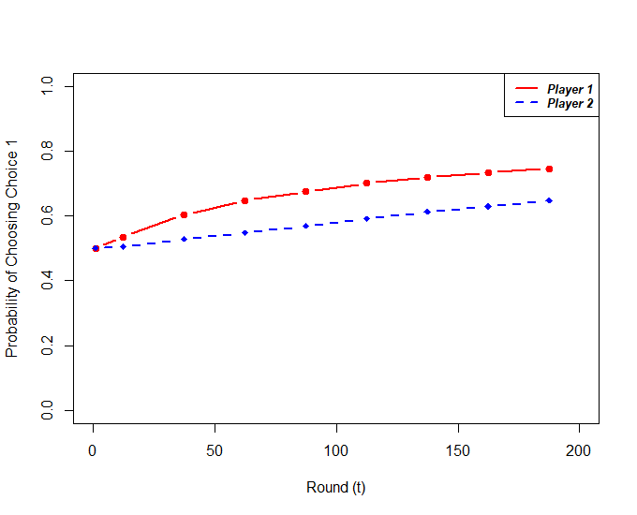
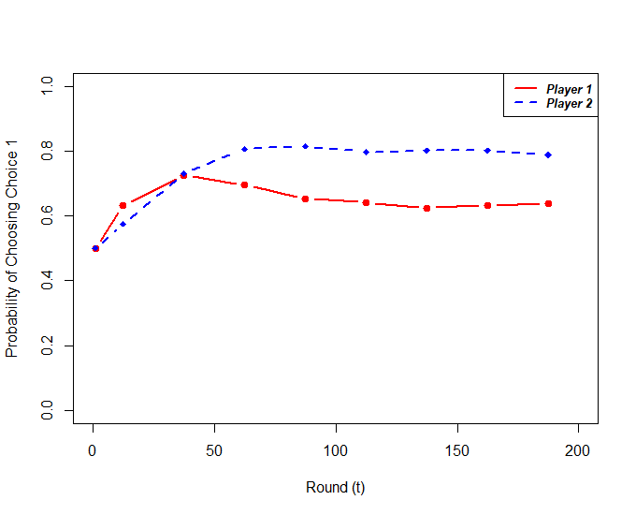

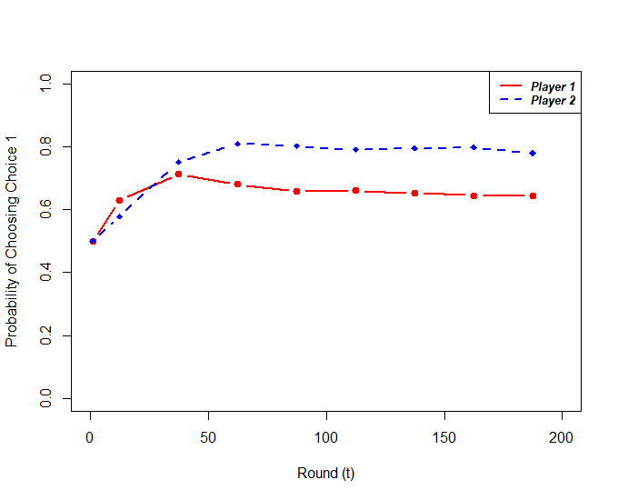
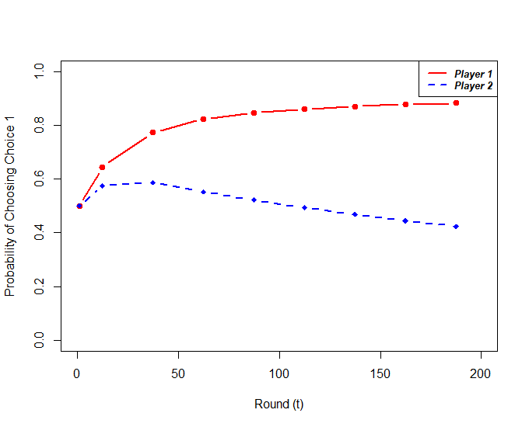
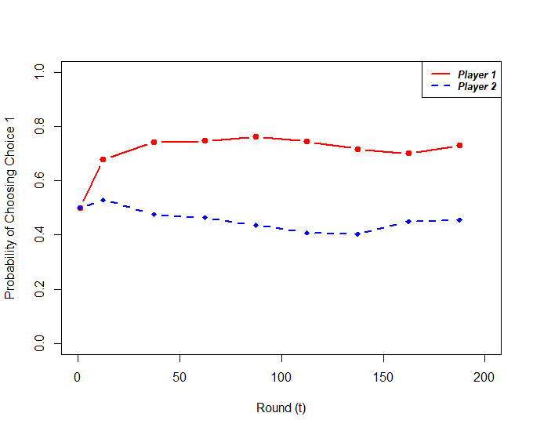
Model Recreation – Directional Results

Slide 9
Model Recreation – Directional Results

Slide 10
Model Recreation – Directional Results

Slide 11
Model Recreation – Directional Results

Slide 12
R Script Demo

Slide 13
Critiques on Model Formulation
Model is probabilistic but no confidence ranges or iteration details given
‘Forgetting’ and ‘Experimentation’ terms
Can be manipulated to get non-physical results: very high forgetting relative to experimentation can quickly invert reward structure
Forgetting is extremely myopic, looking only at current value
Experimentation assumes that choices are ordered (i.e., 1 then 2 then 3 ….)
Implicit assumptions arise from modeling choices
Reward for each player is relative to the lowest reward possible
Loss of any amount may have greater impact
Solutions to different payouts that are multiples of each other are the same
In equilibrium, but the rate of change for larger rewards is faster
This implicitly adds the assumption that the worst case scenario, at minimum, is known a priori
Speed of learning relies on knowing the average payout
Implies participants know the scale of the payouts and adjust accordingly

Slide 14
Critiques on Paper Reproducibility
Direct verification of results is difficult
Original data from the 12 referenced games were not readily available for verification
As a result, difficult to confirm the MSE values in the paper
Model recreation limitations
Probabilistic algorithm but no seed value referenced
Data presented as pre-batched into average groups of 10-40 (typically 20) time steps
Unclear how many iterations were run to obtain the average results seen

Slide 15
Extensions and Suggestions
Include ‘No Choice’ in a more general propensity weighting function
Replace full sequence batching of trials with single trail using Monte Carlo at each time step
Run the simulations longer to see landscape of outcomes
Pure equilibrium assumes rational play at every time step
Implied surface of surface of end states based on previous choices, both rational and not
Interesting to see conditions under which traditional equilibrium is reached or not and what other equilibria may exists

Slide 16

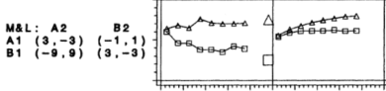
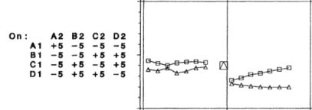
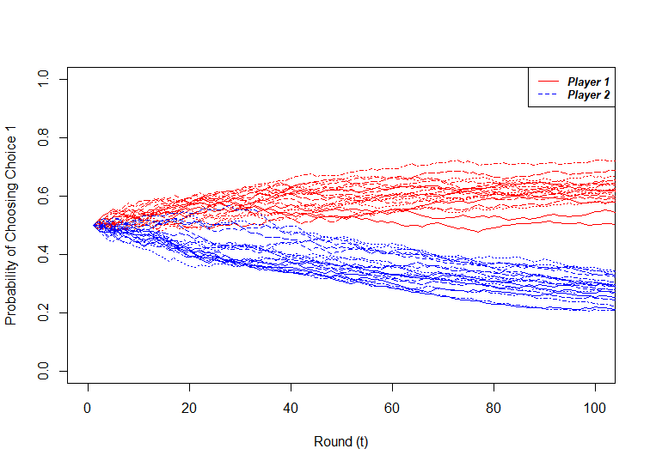
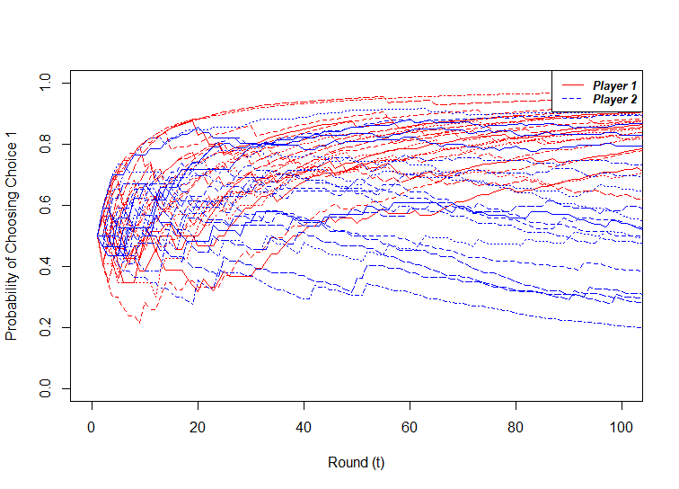
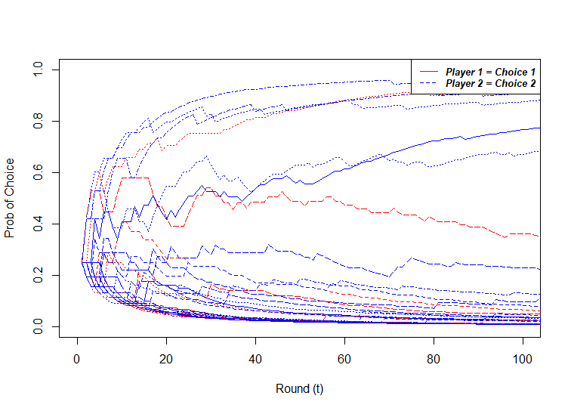
Extensions and Suggestions
Run the simulations longer to see landscape of outcomes
Some simulations generally converge to the aggregate results, but some do not!

